Slide 1
Warmup
@sebawita

Slide 2
Project setup
Clone the workshop repo:
git clone https://github.com/NativeScript/workshop.git
Go inside the warmup folder
cd workshop/warmup
For iOS run:
tns run ios
or use tns preview
For Android run:
tns run android

Slide 3
Lesson 1 UI

Slide 4
Lesson 1 - Setup
For this part of the project we will use the contents of the profile folder:
warmup/app/profile

Slide 5
Lesson 1 - UI
Some of the available UI components:
<Label text="name"></Label>
<TextField hint="your name here" text="Jack"></TextField>
<Switch checked="true"></Switch>
<DatePicker [day]="2" [month]="2" [year]="2002"></DatePicker>
<Slider [minValue]="0" [maxValue]="10" [value]="3"></Slider>
<Button text="Do Something" (tap)="clear()"></Button>

Slide 6
Attribute binding
Add [ ] around the attribute to bind and provide the attribute to bind
<Label [text]="profile.name"></Label>
<TextField [text]="profile.name" hint="name"></TextField>

Slide 7
Events
To bind to an event like:
tap,
doubleTap,
pinch,
pan,
swipe,
rotation,
longPress,
touch

Slide 8
Events
Add ( ) around the event name and provide a function to call
<StackLayout (longPress)="clearForm()">
<Button text="Do Something" (tap)="doSomething()"></Button>
</StackLayout>

Slide 9
Events
If event provides parameters, then add $event
<Label text="Action:" (swipe)="printDirection($event)"></Label>

Slide 10
Two-way binding
For two-way binding use [(ngModel)] and provide the attribute name to bind to.
<TextField [(ngModel)]="email" hint="your name here"></TextField>
<Switch [(ngModel)]="optIn"></Switch>
<DatePicker [(ngModel)]="dob"></DatePicker>
<Slider [(ngModel)]="size" [minValue]="0" [maxValue]="10"></Slider>

Slide 11
Two-way binding
You also need to add NativeScriptFormsModule to @NgModule imports
import { NativeScriptFormsModule } from 'nativescript-angular/forms';
…
imports: [
NativeScriptModule,
AppRoutingModule,
NativeScriptHttpModule,
NativeScriptFormsModule
],

Slide 12
Theme

Slide 13
Theme for text
Change text color:
- text-primary, text-muted, text-danger
Change text alignment:
- text-center, text-left, text-right to
Apply text transformation
- text-lowercase, text-uppercase, text-capitalize
<Label text="Name" class="text-primary text-right"></Label>
<Label text="Email" class="text-danger"></Label>

Slide 14
Theme for buttons
General style:
- btn, btn-primary, btn-outline, btn-active
Round buttons:
- btn-rounded-sm and btn-rounded-lg
Add color (this only work in conjunction with btn-primary):
- btn-blue, btn-brown, btn-forest, btn-grey, btn-lemon, btn-lime, btn-ruby and btn-sky

Slide 15
Theme for buttons
<Button text="Primary" class="btn btn-primary"></Button>
<Button text="Outline" class="btn btn-outline"></Button>
<Button text="Orange" class="btn btn-primary btn-ornage"></Button>
<Button text="Rounded Grey"
class="btn btn-primary btn-grey btn-rounded-sm"></Button>

Slide 16
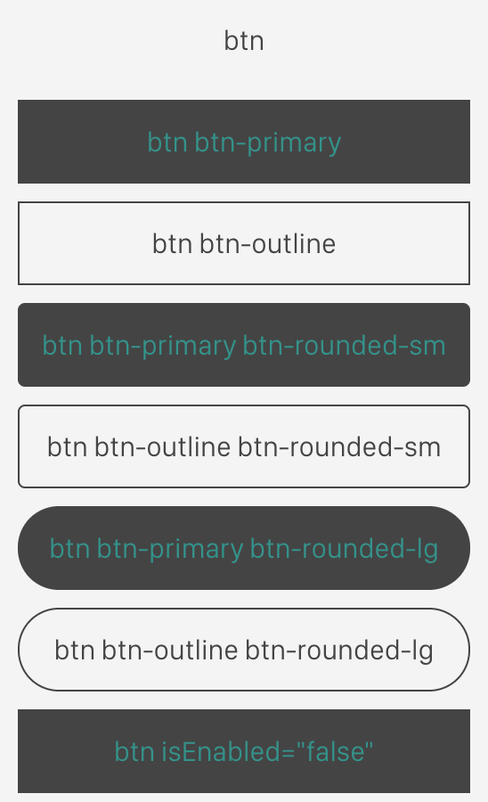
Theme for buttons

Slide 17
Theme other UI components
ActionBar styling:
<ActionBar title="Title" class="action-bar"></ActionBar>
Switch styling:
<Switch [(ngModel)]="optIn" class="switch"></Switch>
Slider styling:
<Slider [(ngModel)]="size" class="slider"></Slider>

Slide 18
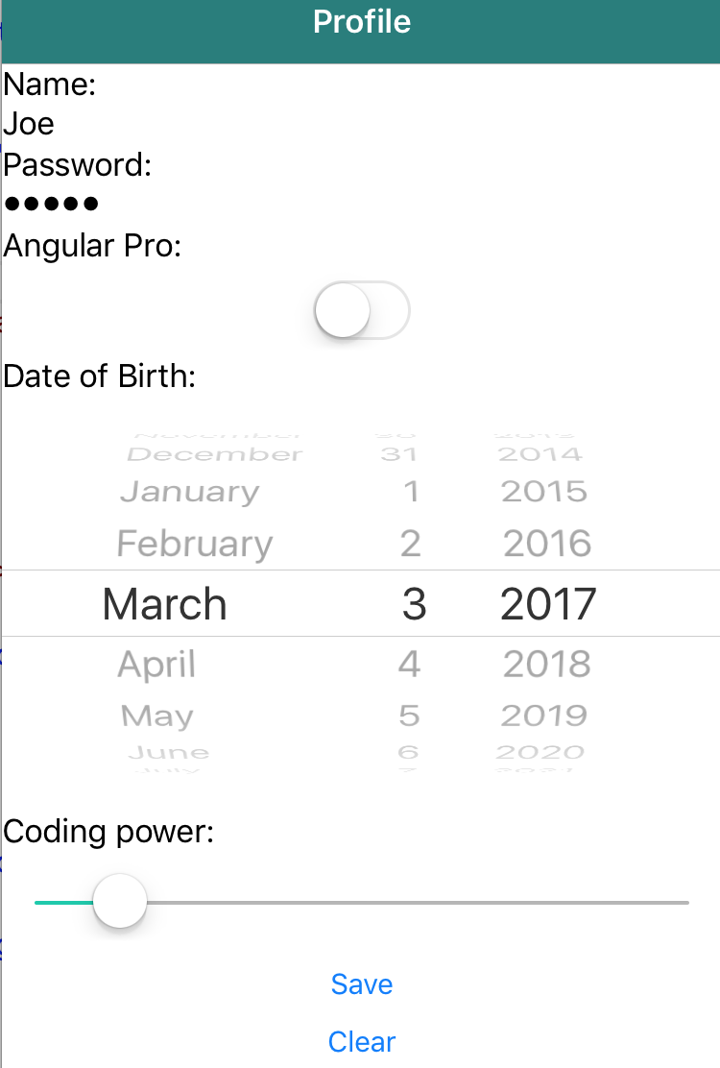
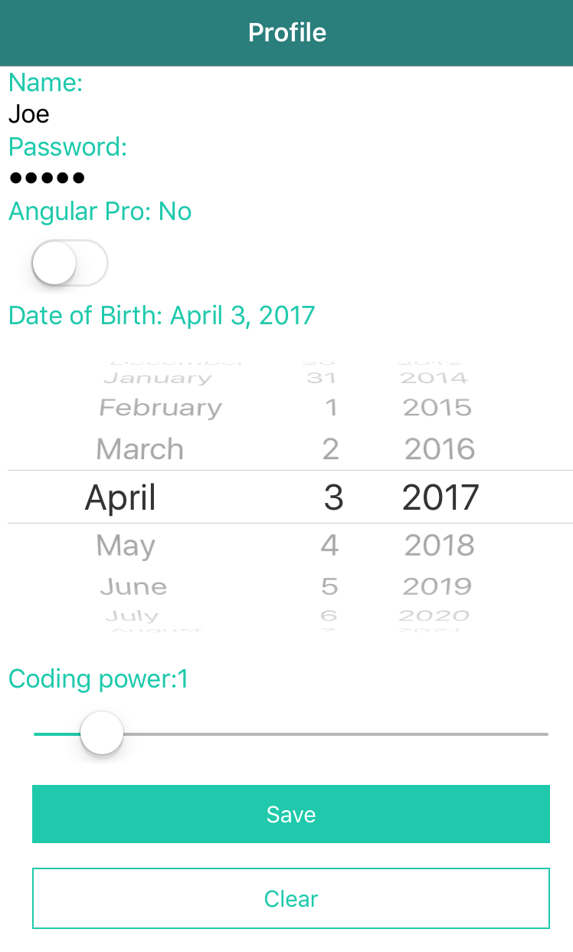
Theme before after

Slide 19
Theme margin and padding
Use m for Margin and p for Padding
Add direction:
-t: top
-b: bottom
-l: left
-r: right
-x: horizontal (left and right)
-y: vertical (top and bottom)

Slide 20
Theme margin and padding
Add size:
-0, -2, -4, -5, -8, -10, -12, -15, -16, -20, -24, -25, -28, -30

Slide 21
Theme margin and padding
Examples:
Margin all directions 20:
m-20
Margin Right 10
m-r-10
Padding Left and Right 2
p-x-2

Slide 22
Animations
1. Leveraging Angular-style animation
2. Use NativeScript's built-in animation library
3. Use Animate.css
4. Use CSS keyframe animation techniques
5. Use Lottie (AirBnB's library) or Keyframes (by Facebook) animations
6. Use a community-generated animation plugin

Slide 23
NativeScript UI
Premium (but FREE) components to make your app even better
https://www.nativescript.org/ui-for-nativescript

Slide 24
Animations
You can use keyframe animations like:
@keyframes zoom {
from { transform: scale(0.5, 0.5) }
40% { transform: scale(1.6, 1.6) }
to { transform: scale(1.0,1.0) }
}
.zoom {
animation-name: zoom;
animation-duration: 2s;
}

Slide 25
Animations
Then apply it to a UI component like:
<Label [text="'Coding power:' + profile.codingPower"
class="text-primary”
[class.zoom]="profile.codingPower > 7">
</Label>

Slide 26
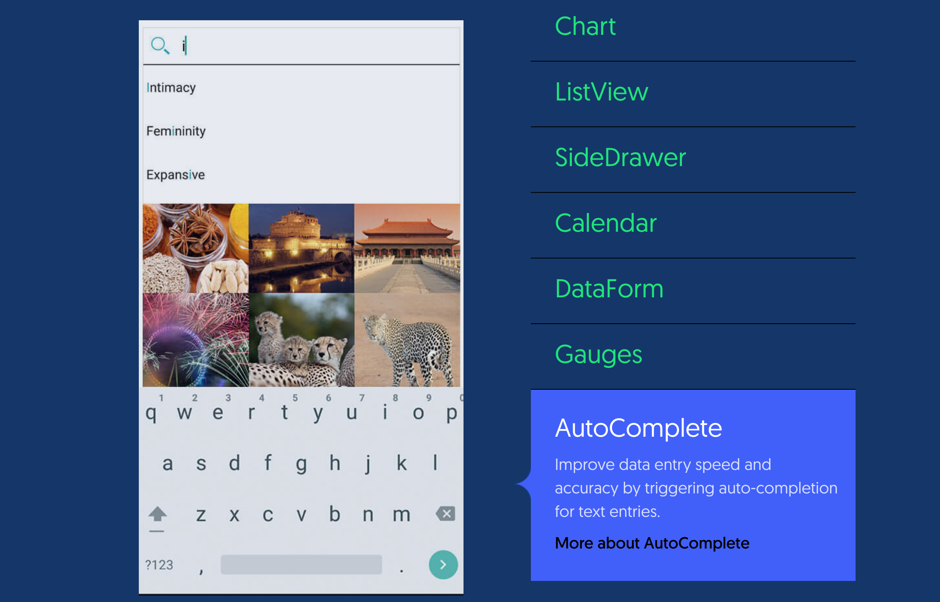

Slide 27
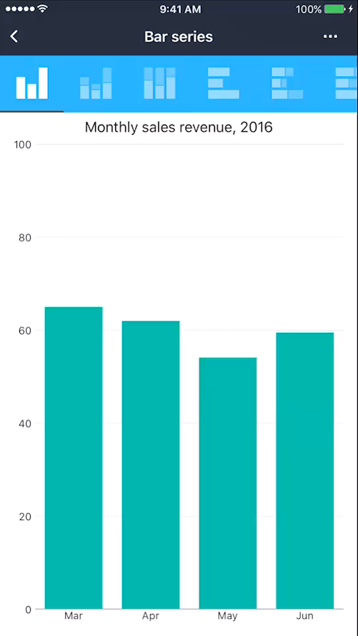
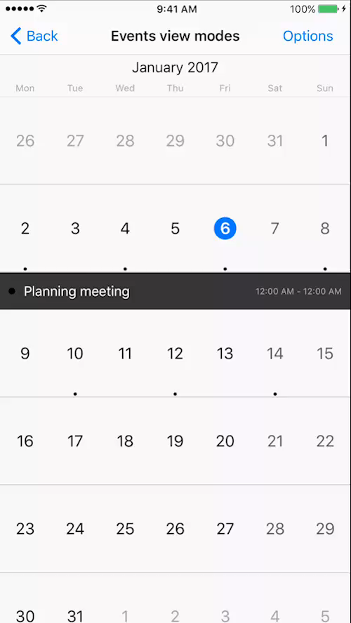

Slide 28
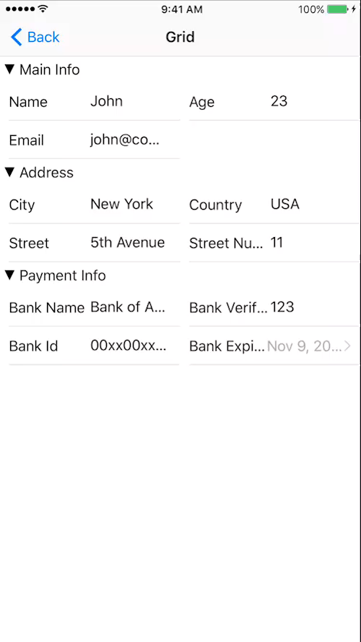
RadDataForm
JSON DataSource + HTML =

Slide 29
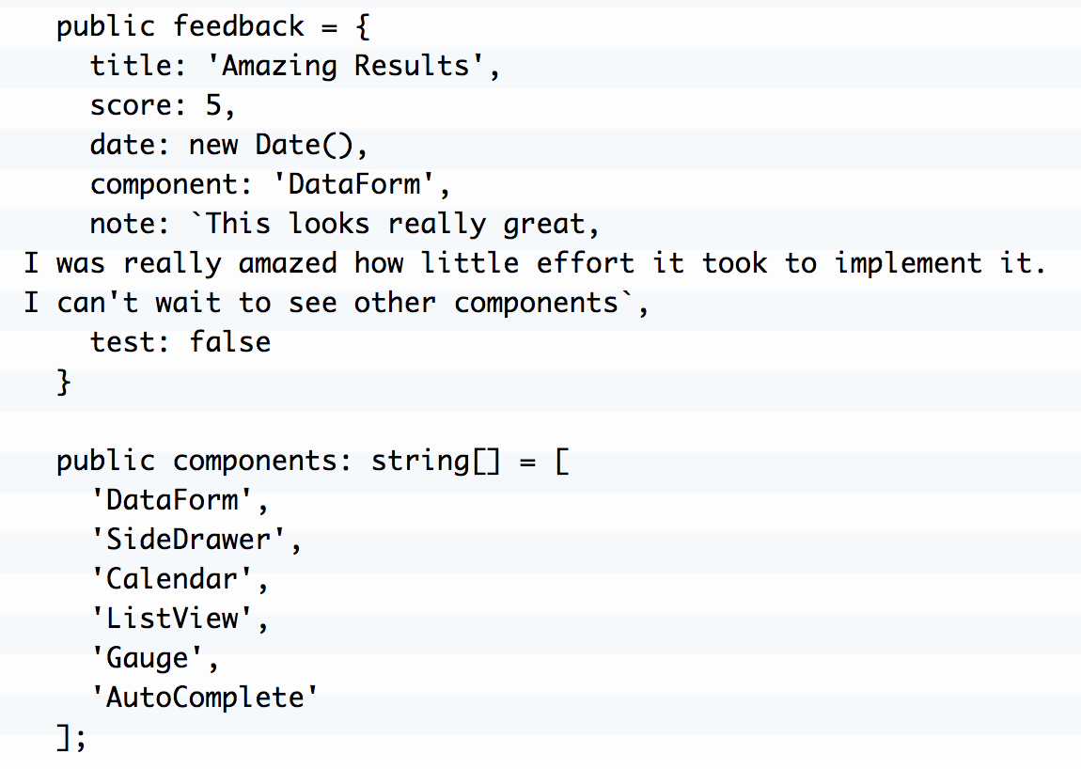
DataSource

Slide 30
DataSource

Slide 31
Installation
tns plugin add nativescript-ui-dataform

Slide 32
Configuration
Add the required modules to the @NgModule:
import { NativeScriptUIDataFormModule } from 'nativescript-ui-dataform/angular';
...
@NgModule(
{
imports: [
NativeScriptUIDataFormModule,
...
],
...
}
)

Slide 33
Binding to source
<RadDataForm [source]="feedback"> </RadDataForm>

Slide 34
Populating properties
<RadDataForm [source]="feedback">
<TKEntityProperty tkDataFormProperty
name="name"
displayName="displayName"
index="1">
</TKEntityProperty>
</RadDataForm>

Slide 35
Editor: Date Picker
<RadDataForm [source]="feedback">
<TKEntityProperty tkDataFormProperty
name="date" displayName="Date" index="3">
<TKPropertyEditor
tkEntityPropertyEditor
type="DatePicker">
</TKPropertyEditor>
</TKEntityProperty>
</RadDataForm>

Slide 36
Editor: List Based
<TKEntityProperty tkDataFormProperty
name="component" displayName="Component" index="4"
[valuesProvider]="components">
<TKPropertyEditor
tkEntityPropertyEditor
type="Picker">
</TKPropertyEditor>
</TKEntityProperty>

Slide 37
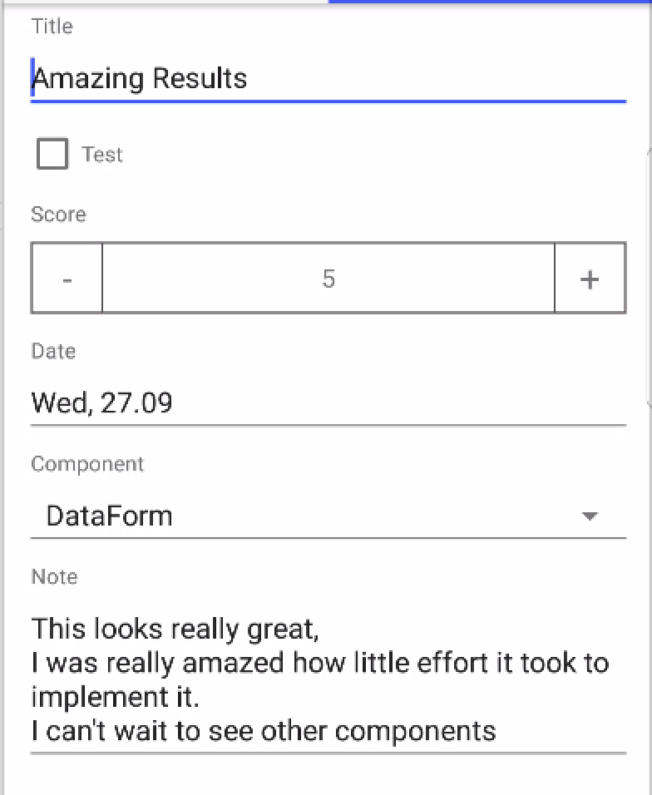
Result

Slide 38
Lesson 1 Exercises
For this exercises we will use the contents of the app/profile folder

Slide 39
Exercise: Use UI components (3.2)
Modify: profile.component.html to:
- recreate this UI
- bind the input components to
the profile property
- bind the save and clear buttons
to call the save() and clear() functions.

Slide 40
Exercise: Two way binding (3.4)
Modify: profile.component.html to:
- use two-way binding with [(ngModel)] for all input components
(TextField, Switch, DatePicker, Slider)
- remember to add NativeScriptFormsModule to @NgModule
Hint:
DatePicker [(ngModel)] takes a whole date object

Slide 41
Exercise: Theme (3.6)
Add theme styling to profile.component.html
Hint 1: Add margin to the main <StackLayout>
Hint 2: For small screens use <ScrollView>
<ScrollView>
<StackLayout>
...
<StackLayout>
</ScrollView>

Slide 42
Exercise: Theme (3.6)
Open app.css and try these themes
aqua.css
blue.css
brown.css
core.dark.css
core.light.css
forest.css
grey.css
lemon.css
lime.css
orange.css
purple.css
ruby.css
sky.css

Slide 43
Bonus Exercise: Theme Builder (3.6)
Go to http://www.nativescriptthemebuilder.com/#
Create your own theme
Export it
Add it to your project

Slide 44
Exercise: Animations (3.8)
Update the slider component, so that it activates the danger-slider css class when profile.codingPower > 7
Also edit the label above the slider, so that it activates zoom the zoom css class profile.codingPower > 7
Can you make the label spin instead of zoom?

Slide 45
Exercise: NativeScript UI (3.10)
Populate the RadDataView with the Entity Properties
Make sure to check the documentation for the list of available editors:
http://docs.telerik.com/devtools/
nativescript-ui/Controls/Angular/DataForm/Editors/dataform-editors-list

Slide 46
Exercise: NativeScript Layouts (External)
https://www.nslayouts.com/

Slide 47
Lesson 2 Navigation

Slide 48
Lesson 2 – Navigation Setup
For this part of the project we will use the contents of the color folder:
warmup/app/color

Slide 49
Routing configuration
Initial routes config in NativeScript:
const routes: Routes = [
{ path: "", redirectTo: "/items", pathMatch: "full" },
{ path: "items", component: ItemsComponent },
{ path: "item/:id", component: ItemDetailComponent },
];

Slide 50
Routing configuration
{ path: "", redirectTo: "/items", pathMatch: "full" },
Sets up the default path to redirect to /items path by default
When the app starts it will automatically navigate to /items

Slide 51
Routing configuration
{ path: "items", component: ItemsComponent },
Sets up the items path to navigate to ItemsComponent

Slide 52
Routing configuration
{ path: "item/:id", component: ItemDetailComponent },
Sets up the item + id path to navigate to the ItemDetailComponent
Additionally it will provide the id as the parameter into the ItemDetailComponent
For example: calling navigate to "/item/25" will open the ItemDetailComponent with id = 25

Slide 53
Routing configuration: Parent/Child
const routes: Routes = [
{ path: '', redirectTo: '/articles', pathMatch: 'full' },
{ path: 'items', children: [
{ path: '', component: ItemsComponent },
{ path: ':id', component: ItemDetailComponent },
]},
{ path: 'articles', children: [
{ path: '', component: ArticlesComponent },
{ path: 'read/:id', component: ArticleComponent },
{ path: 'edit/:id', component: EditArticleComponent },
{ path: 'search/:tech/:keyword', component: ArticleSearchResultsComponent },
]},
];

Slide 54
Routing configuration: Parent/Child
const routes: Routes = [
…
{ path: 'articles', children: [
{ path: '', component: ArticlesComponent },
{ path: "read/:id", component: ArticleComponent },
{ path: "edit/:id", component: EditArticleComponent },
{ path: "search/:tech/:keyword", component: ArticleSearchResultsComponent }
]}
];
Navigate to "/articles" will trigger this path

Slide 55
Routing configuration: Parent/Child
const routes: Routes = [
…
{ path: 'articles', children: [
{ path: '', component: ArticlesComponent },
{ path: "read/:id", component: ArticleComponent },
{ path: "edit/:id", component: EditArticleComponent },
{ path: "search/:tech/:keyword", component: ArticleSearchResultsComponent }
]}
];
Navigate to "/articles/read/25" will trigger this path
And pass 25 as the id

Slide 56
Routing configuration: Parent/Child
const routes: Routes = [
…
{ path: 'articles', children: [
{ path: '', component: ArticlesComponent },
{ path: "read/:id", component: ArticleComponent },
{ path: "edit/:id", component: EditArticleComponent },
{ path: "search/:tech/:keyword", component: ArticleSearchResultsComponent }
]}
];
Navigate to "/articles/search/web/angular" will trigger this path
And pass web as the tech and angular as the keyword

Slide 57
Navigation from template
Add [nsRouterLink] to provide navigation instructions
<Label text="Angular Navigation"
[nsRouterLink]="['/articles/read', '5']">
</Label>
Will navigate to '/articles/read/5' path.

Slide 58
Navigation from template Relative paths
Navigate to parent:
[nsRouterLink]="['..']"
Navigate to sibling: [nsRouterLink]="['../sibling']"
Navigate to child: [nsRouterLink]="['./child']"
[nsRouterLink]="['child']"

Slide 59
Navigation from template Clear History
Use clearHistory to clear the navigation stack
<Label text="Back to Articles" [nsRouterLink]="['..']"
clearHistory="true">
</Label>

Slide 60
Navigation with code
Navigation is easy:
1. import the router you need,
2. inject the router in the constructor,
3. call navigate
import { Router } from '@angular/router';
// or
import { RouterExtensions } from 'nativescript-angular';

Slide 61
Navigation with code
Navigation is easy:
1. import the router you need,
2. inject the router in the constructor,
3. call navigate
constructor(private router: RouterExtensions) {
}

Slide 62
Navigation with code
Navigation is easy:
1. import the router you need,
2. inject the router in the constructor,
3. call navigate
readArticle(id: number) {
this.router.navigate(['/articles/read', id]);
}

Slide 63
Navigation with code Router vs RouterExtensions
RouterExtensions provides additional options like:
Page transition
Navigate back
Clear History
Etc.

Slide 64
Navigation with code Relative Path
1. import ActivatedRoute
2. inject it in the constructor
3. provide it as a parameter for `navigate`, as `relativeTo`
import { ActivatedRoute } from '@angular/router';

Slide 65
Navigation with code Relative Path
1. import ActivatedRoute
2. inject it in the constructor
3. provide it as a parameter for `navigate`, as `relativeTo`
constructor(
private router: RouterExtensions,
private route: ActivatedRoute) {
}

Slide 66
Navigation with code Relative Path
1. import ActivatedRoute
2. inject it in the constructor
3. provide it as a parameter for `navigate`, as `relativeTo`
this.router.navigate(['./read', id], { relativeTo: this.route });

Slide 67
Navigation with code Relative Path
Navigate to parent:
this.router.navigate(['..'], {relativeTo: this.route});
Navigate to sibling: this.router.navigate(['../sibling'], {relativeTo: this.route});
Navigate to child: this.router.navigate(['./child'], {relativeTo: this.route});
this.router.navigate(['child'], {relativeTo: this.route});

Slide 68
Clear History
To clear history just provide clearHistory into navigate, as an optional parameter:
this.router.navigate(['/articles', { clearHistory: true }]);

Slide 69
Navigating back
There are two functions available from RouterExtensions:
this.router.back() – goes one step back
this.router.backToPreviousPage() – goes to the previous page

Slide 70
Navigating back back vs backToPreviousPage
1. navigate `/articles`
2. navigate `/articles/read/1`
3. navigate `/articles/read/4`
4. navigate `/articles/edit/6`
ArticlesComponent
ReadComponent
EditComponent
[1] articles
[2] read/1
[4] edit/6
[3] read/4

Slide 71
Navigating back back vs backToPreviousPage
this.router.back();
ArticlesComponent
ReadComponent
EditComponent
[1] articles
[2] read/1
[4] edit/6
[3] read/4

Slide 72
Navigating back back vs backToPreviousPage
this.router.backToPreviousPage();
ArticlesComponent
ReadComponent
EditComponent
[1] articles
[2] read/1
[4] edit/6
[3] read/4

Slide 73
Receiving parameters
1. import ActivatedRoute
2. inject it in the constructor
3. extract the params from route.snapshot.params
import { ActivatedRoute } from '@angular/router';

Slide 74
Receiving parameters
1. import ActivatedRoute
2. inject it in the constructor
3. extract the params from route.snapshot.params
constructor(
private router: RouterExtensions,
private route: ActivatedRoute) {
}

Slide 75
Receiving parameters
1. import ActivatedRoute
2. inject it in the constructor
3. extract the params from route.snapshot.params
ngOnInit() {
this.tech = this.route.snapshot.params['tech'];
this.keyword = this.route.snapshot.params['keyword'];
this.searchArticles(this.tech, this.keyword);
}

Slide 76
Receiving parameters Navigating to self
Use route.params Observable and then the snapshot.
ngOnInit() {
this.route.params.forEach(params => {
this.tech = params['tech'];
this.keyword = params['keyword'];
this.searchArticles(this.tech, this.keyword);
});
}

Slide 77
Page Transitions
curl (same as curlUp) (iOS only)
curlUp (iOS only)
curlDown (iOS only)
explode (Android only)
fade
flip (same as flipRight)
flipRight
flipLeft
slide (same as slideLeft)
slideLeft
slideRight
slideTop
slideBottom

Slide 78
Page Transitions Template
Add pageTransition and the name of the required transition
<Button
text="Open Path"
[nsRouterLink]="['/path']"
pageTransition="slideBottom">
</Button>

Slide 79
Page Transitions Code
Provide transition attribute into the optional parameters:
this.router.navigate(['/relative/path'], {
transition: {
name: 'slideBottom',
duration: 500,
curve: 'linear'
}
});

Slide 80
Lesson 2 Exercises
For this exercises we will use the contents of the app/color folder
Open app.routing.ts and update the default path to /color
{ path: '', redirectTo: '/color', pathMatch: 'full' },

Slide 81
Exercise: Routing configuration (4.2)
app.routes.ts already contains routes for the ColorComponent and the BlueComponent
Your task is to add new routes so that:
- color/red navigates to RedComponent
- color/rgb + rgb navigates to RGBComponent, while passing the rgb as the parameter

Slide 82
Exercise: Navigation with nsRouterLink (4.4)
Update color.component.html, so that:
1. the Blue button navigates to the BlueComponent
2. the Red button navigates to the RedComponent
3. the Pink button navigates to the RGBComponent
with '#ff0088' as the rgb parameter
4. the Gray button navigates to the RGBComponent
with 'gray' as the rgb parameter
5. the Lavender button navigates to the RGBComponent
with '#bad' as the rgb parameter
FYI: the rgb parameter will NOT have any effect on to the RGBComponent. This will come later.

Slide 83
Exercise: Navigation with code (4.6)
Implement the empty functions in blue.component.ts, so that:
1. goRed() navigates to the Red page
2. goPink() navigates to the RGB page with this.pink as the parameter
3. goBack() navigates back
4. goHome() navigates home whilst clearing the navigation history

Slide 84
Exercise: Receiving parameters (4.8)
Update rgb.component.ts so that it receives the rgb parameter and updates this.rgb
Hint: You might want to use the routes.params Observable

Slide 85
Exercise: Page Transitions: Step 1 In html template (4.10)
Update color.component.html, so that:
1. The Blue button triggers curl transition
2. The Red button triggers the explode transition
3. The Pink, Gray and #bad buttons trigger the flip transition

Slide 86
Exercise: Page Transitions: Step 1 In html template (4.10)
Hint: you will need to use the pageTransition="fade" html attribute

Slide 87
Exercise: Page Transitions: Step 2 In TypeScript class (4.10)
Hint: you will need to pass the transition param into router.navigate:
this.router.navigate(['/relative/path'], {
transition: {
name: 'slideBottom',
duration: 500,
curve: 'linear'
}
});

Slide 88
Exercise: Page Transitions: Step 2 In TypeScript class (4.10)
Update color.component.html, so that:
1. goBlue() navigates to the Blue page with:
page transition slideTop
duration 2 seconds
curve spring
2. goGray() navigates to the RGB page with gray as the parameter and:
page transition fade
duration 1 second

Slide 89
Lesson 3 – Components and Services
For this part of the project we will use the contents of the football folder:
warmup/app/football

Slide 90
The real Football

Slide 91
Services

Slide 92
Services Creating a service
import { Injectable } from '@angular/core';
@Injectable()
export class MyHappyService {
public doSomethingFun() {
console.log('I am a happy bunny... hop, hop, hop');
}
}

Slide 93
Services Naming convention
MyHappyService => my-happy.service.ts
CurrencyPipe => currency.pipe.ts
NavigationMenuComponent => navigation-menu.component.ts
LoginModel => login.model.ts

Slide 94
Services Adding the service to @ngModule
import { MyHappyService } from './my-happy.service';
@NgModule({
...
providers: [
MyHappyService
],
…
})

Slide 95
Services Injecting the service
import { MyHappyService } from '../my-happy.service';
constructor(private myHappyService: MyHappyService) {
//constructor code
}
showYourMood() {
this.myHappyService.doSomethingFun();
}

Slide 96
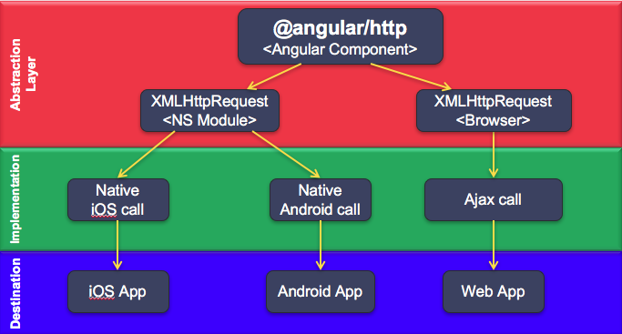
HTTP

Slide 97
HTTP @ngModel imports
import { NativeScriptHttpClientModule} from
'nativescript-angular/http-client';
@NgModule({
imports: [
...
NativeScriptHttpClientModule,
],
…
})

Slide 98
HTTP In 3 easy steps
Import
Inject
Call
import { HttpClient } from '@angular/common/http';

Slide 99
HTTP In 3 easy steps
Import
Inject
Call
constructor(private http: HttpClient) {
//constructor code
}

Slide 100
HTTP In 3 easy steps
Import
Inject
Call
this.http.get('http://api.someopendata.org/cities')

Slide 101
HTTP Example
this.http.get('http://api.someopendata.org/cities')
.subscribe(
result => console.log(result.cities),
error => console.error('Error: ' + error),
() => console.log('Completed!')
)

Slide 102
HTTP With a promise
this.http.get('http://api.someopendata.org/cities')
.toPromise()
.then(
result => console.log(result.cities),
error => console.error('Error: ' + error)
)

Slide 103
HTTP Adding headers
1. Set value:
let myHeaders = new HttpHeaders();
myHeaders.append('key', 'value');
2. Pass into an http call:
this.http.get('http://api.someopendata.org/cities',
{ headers: myHeaders }
)

Slide 104
HTTP Adding search params
For url like: http://my.service.io?mood='happy'&face='round’
1. Construct:
let searchParams = new HttpParams();
searchParams = searchParams.set('mood', 'happy');
searchParams = searchParams.set('face', 'round');
2. Pass into an http call:
this.http.get('http://api.someopendata.org/cities',
{ headers: myHeaders, search: searchParams }
);

Slide 105
Components

Slide 106
Components
@Component({
selector: 'my-blue',
templateUrl: './color/blue.component.html',
styleUrls: ['./color/color.component.css']
})
export class BlueComponent{
private pink: string = '#ff0088';
constructor() { }
// other functions
}

Slide 107
Components @ngModule declaration
@NgModule({
…
declarations: [
AppComponent,
ProfileComponent,
ColorComponent,
BlueComponent,
]
…
})

Slide 108
Components @ngModule declaration: error reminder
When you see an error like:
Component BlueComponent is not part of any NgModule or the module has not been imported into your module.

Slide 109
Components Smart vs Presentation components
Smart – contains the application logic
Presentation – used just to display some data

Slide 110
Component with custom input (one-way binding)
export class CalendarComponent {
@Input() day: number;
@Input() month: number;
private _year: number;
@Input() set year(year: number) {
this._year = (year > 100) ? year : year + 2000;
}

Slide 111
Component with custom input (one-way binding)
@Component({
selector: 'my-calendar',
templateUrl: './calendar/calendar.component.html'
})
export class CalendarComponent {
@Input() day: number;
@Input() month: number;
private _year: number;
@Input() set year(year: number) {
this._year = (year > 100) ? year : year + 2000;
}

Slide 112
Component with custom input (one-way binding)
<my-calendar day="12" month="11" year="10"></my-calendar>

Slide 113
Components with custom events HTML template
<ListView [items]="table?.standing" class="list-group"
(itemTap)="onTeamSelect($event)">

Slide 114
Components with custom events Component Class
@Output() teamSelected = new EventEmitter<number>();
onTeamSelect(event) {
const selectedTeamId = this.table.standing[event.index].teamId;
console.log('::LeagueTableComponent::onTeamSelect::' + selectedTeamId);
this.teamSelected.emit(selectedTeamId);
}

Slide 115
Components with custom events Use like this
<my-league-table [competitionId]="PremierLeagueId"
(teamSelected)="onTeamTap($event)">
</my-league-table>

Slide 116
Components with custom input (two-way binding)
@Component({
selector: 'color-picker',
templateUrl: './color-picker/color-picker.component.html'
})
export class ColorPickerComponent {
@Input color: string;
@Output() colorChange = new EventEmitter<string>();
onColorPick(newColor: string) {
colorChange.emit(newColor);
}
}

Slide 117
Components with custom input (two-way binding)
<color-picker [(color)]="selectedColorFromParentClass">
</color-picker>

Slide 118
Lesson 3 Exercises
For this exercises we will use the contents of the app/service-test folder and then later app/football
Open app.routing.ts and update the default path to /service-test
{ path: '', redirectTo: '/service-test', pathMatch: 'full' },

Slide 119
Exercise: Football Service (5.2)
Update football.service.ts:
- Implement missing functions
- Use your knowledge from 5.1 on how to call http.get

Slide 120
Exercise: Creating a presentation component with @Input (5.5)
Refactor LeageFixturesComponent, so that it uses <my-fixture> instead of the GridLayout.
Add @Input() to FixtureComponent to capture fixture value.
Upadate FixtureComponent html to bind to fixture values

Slide 121
Exercise: Creating a presentation component with @Output (5.7)
When user taps on a team, it should navigate to the TeamComponent.
- Update the LeagueTableComponent to emit teamSelected with the teamId.
- Update the TablesComponent to intercept the teamSelected event
=> call onTeamSelected => navigate to TeamComponent

Slide 122
Bonus Component Exercise (5.9)
Implement PlayerComponent.
Player should display:
name, position, jerseyNumber and nationality
Update the TeamComponent to display a list of players instead of a list of fixtures.

Slide 123
Lesson 4 - Plugins

Slide 124
Camera Plugin

Slide 125
Social Share Plugin

Slide 126
Fancy Alert Plugin

Slide 127
Pull To Refresh Plugin

Slide 132


